Slide 1
NASTT No-Dig Show PowerPoint Guidelines

Slide 2
Understanding Your Audience
Remember that your audience wants you to share your knowledge and experience.
The highest ratings in post-show surveys are given to those that effectively deliver valuable information without commercialism.

Slide 3
Defining Your Audience
Most in attendance understand the basics of underground construction and rehabilitation but are less likely to be an expert on the topic you are presenting.
Engineers, contractors, students and field experienced individuals make up NASTT No-Dig Show attendees.
Target your audience’s level of understanding.

Slide 4
Color & Theme
It is REQUIRED that you use the No-Dig Show template for your presentation. It can be downloaded on the Speaker Resource page on the No-Dig Show website.
Use colors sparingly for more effect and to avoid overwhelming the audience.

Slide 5
Copy & Text
Don’t fall into the trap of using too much text. Use your presentation as an overview, not as a complete statement.
Bullet points, abbreviated statements, graphics, photographs and media clips will allow the attendee to listen to your presentation vs. concentrating on reading the slides.

Slide 6
Number of Slides
Make sure you can discuss the points shown on the slides in the time allotted for your presentation.
All presentations are 25 minutes including time for speaker introduction and a 5-minute Q&A period.
Don’t prepare too many slides. No more than 25 slides is suggested.

Slide 7
Visuals
Choose visuals that represent your topic and deliver your message. Relevance and simplicity are important.
Do not place a table full of text into your presentation only to tell the audience they can’t read it.
Refer to your paper and the proceedings for more detailed information if necessary.

Slide 8
Image Slide Sample

Slide 9
Image Slide Sample
Images keep your audience engaged
A picture is worth a thousand words!

Slide 10
The Use of Company Logos
Company logos may appear on first and last slides only.
NASTT prides itself on presenting material with no commercialism, so please make sure your presentation is not a sales pitch.

Slide 11
The Use of Media Clips
If media clips are embedded in your presentation, please alert your track leader.
You must load the media file as a separate file in the Pheedloop system.
Presenters must verify that media clips are working correctly in the Speaker Ready Room on Sunday, April 30 from 12:00-2:00 PM and immediately before your session starts (the first presentation in your track).

Slide 12
Images
Make sure you optimize image size used to keep the file size of the PowerPoint presentation reasonable.
Typically an image of 800 pixels in width (about 8”) is the optimum file size.
Do not cut and paste images into your presentation. Go to the insert tab and select the picture icon to add them so your file size doesn’t become too large.

Slide 13
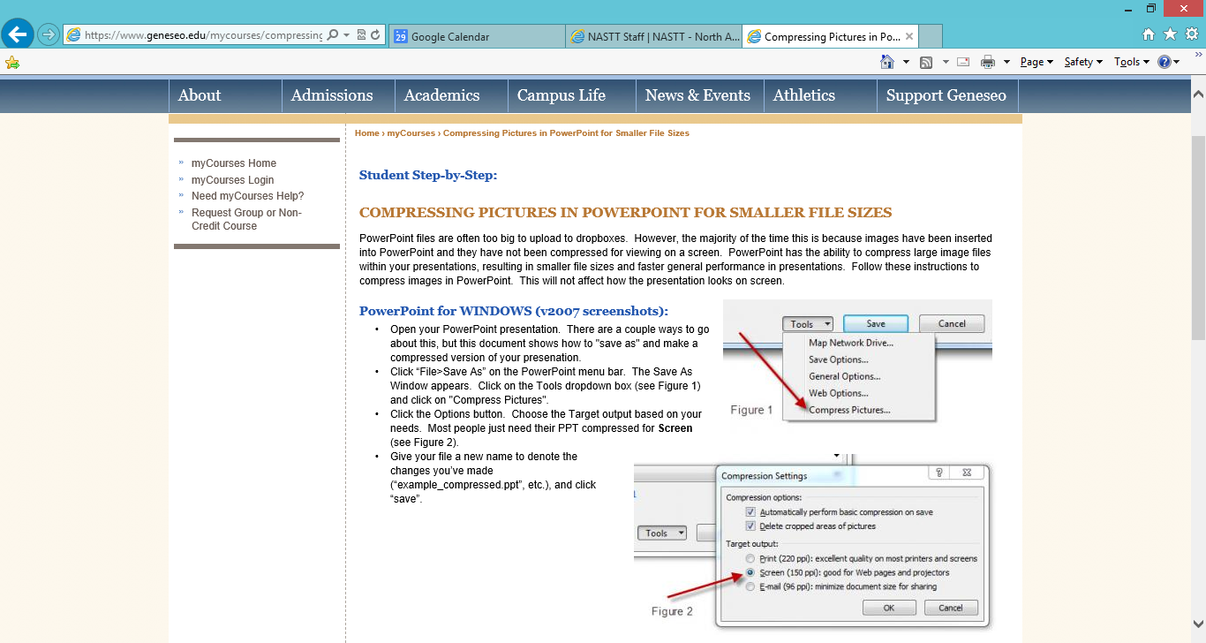

Slide 14
Draft Submission Deadlines
Authors must submit draft PowerPoint presentations for review.
Deadline: November 7, 2022

Slide 15
Draft Submission Deadlines
Draft PowerPoint presentations must be uploaded into the Pheedloop management system.
Click on the link in your acceptance email
Select Session Files (left toolbar)
Add file description (name of your abstract with “PPT” after)
Choose file using the ‘Browse’ button
Click on ‘Add File’ to save the document

Slide 16
Content Review
Your track leader will review your presentation on the following:
Non-commercialism & objectivity
Meaningfulness & relevance
Format and template use
Ease of reading

Slide 17
Final Submission Deadlines
Once you submit your draft you will be assigned a session (example: MM-T1-01)
Final presentations should be named with the session # (MM-T1-01)
Deadline: March 13, 2023

Slide 18
Submission Guidelines
Presenters will not be allowed to use their own computers.
All presentations will be uploaded to a centralized laptop computer in advance of the conference. You will not be able to bring your presentation to the session on a flash drive.

Slide 19
Practices Makes Perfect
Know the content of your presentation.
Do not “read” your slides. Share your knowledge and use the presentation slides to remind you what to say next.
Time yourself to be sure you can deliver your presentation within the limits allowed.
Make sure you leave time for questions from your audience.

Slide 20
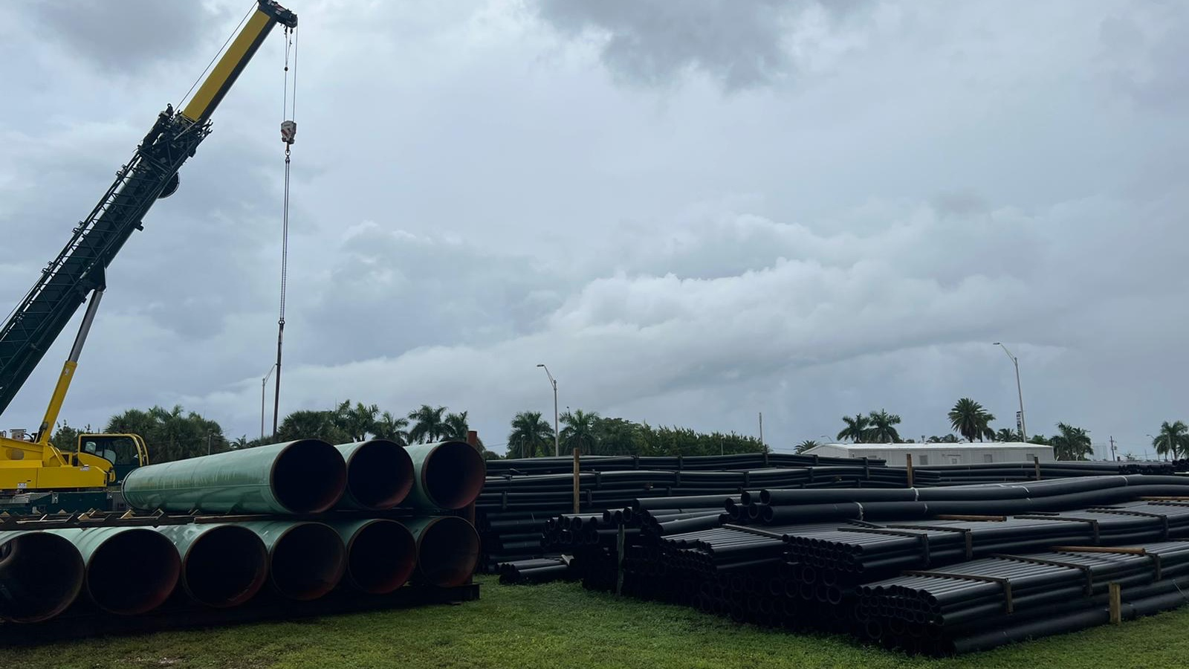
Questions? Contact your track leader or Michelle Hill at mhill@nastt.org

